Slide 1

Database system for efficient disaster relief and resource management
CSA0580 Database Management Systems for Industry Information
GUIDED BY:
Dr.S.Pandiraj
Dr.J.Velmurugan
PRESENTED BY:
V.Shiva(192472256)
T.Vasudevanaidu(192472305)
Notes:
V

Slide 2

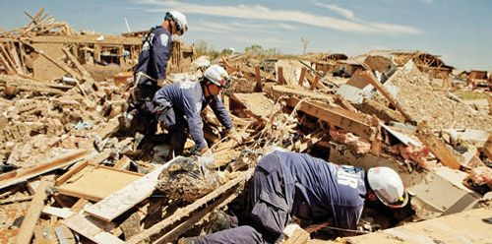
INTRODUCTION
Natural disasters like floods, earthquakes, cyclones, and wildfires threaten lives, property, and the environment.
Quick detection and communication are essential to minimize damage and support effective emergency response.
Existing monitoring systems often face delays, limited coverage, and lack of real-time data analysis.
The system provides early alerts via multiple channels and an interactive dashboard for real-time visualization.
Helps authorities, responders, and the public make faster, better-informed decisions during emergencies.

Slide 3
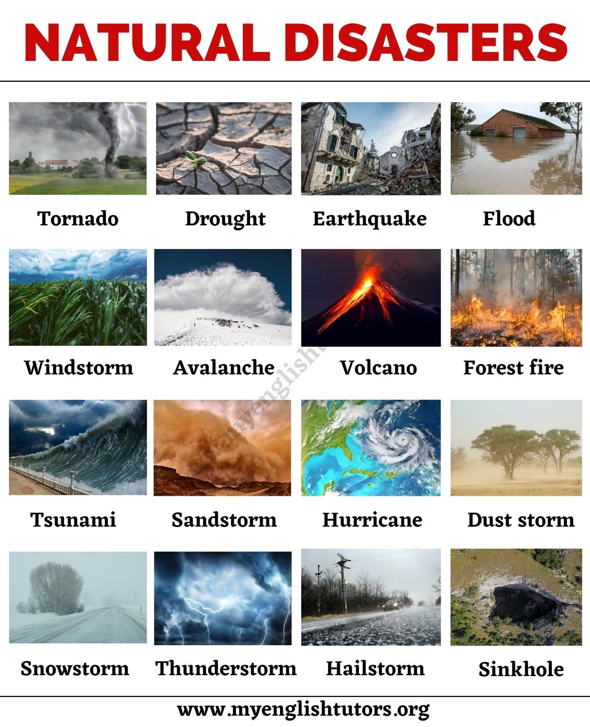
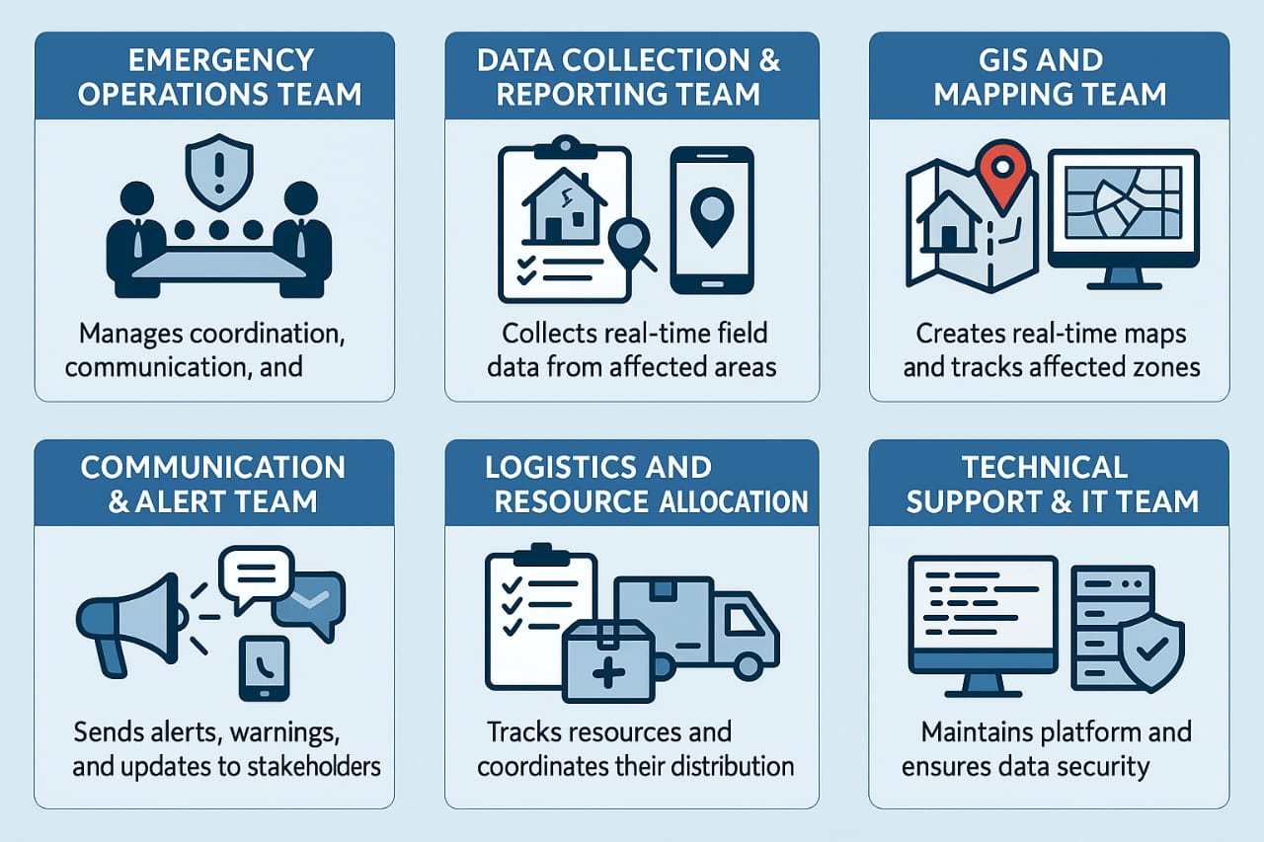

Slide 4

LITERATURE SURVEY
Year | Reference | Focus | Key Contribution
2024 | Kamyabniya et al. | Optimization models for disaster response operations | A comprehensive review of recent advancements in disaster emergency response, focusing on the interplay between machine learning, simulation, and optimization frameworks.
2020 | Farahani et al. | Mass casualty management in disaster scene | A systematic review of research in humanitarian operations, identifying a critical need for integrated systems that can manage casualties, resources, and logistics in real-time.
2020 | Cheikhrouhou et al. | Cloud-based disaster management systems | Proposes a complete cloud-based system that collects data from wireless sensors to create a near-real-time 3D environment for training and planning rescue efforts.
2020 | Oktari et al. | Challenges in disaster management in Southeast Asia | Highlights the need for robust coordination mechanisms, advanced preparedness measures, and the integration of technology to improve disaster response frameworks.

Slide 5
MODULES USED FOR PROBLEM SOLVING
MODULES:
Rescue & Inventory Management
Real-Time Affected Zone Mapping

Slide 6
PROJECT MODULES:
Module | Function | Key Features
1. Rescue & Inventory Management | To provide a real-time system for identifying, locating, and managing victims in disaster zones. This enables first responders to prioritize rescue and medical efforts. | Real-Time Dashboard: Displays live updates on victim status and locations. GPS-Based Tracking: Enables location mapping of victims and rescue teams. Victim Identification System: Assigns unique IDs and stores personal/medical info. Medical Condition Prioritization: Flags victims needing urgent care. Data Sync: All updates reflected immediately across the system. Resource Need Tags: Flags specific areas that require urgent supplies (e.g., food, medical aid, shelter).
2.Real-Time Affected Zone Mapping | To visualize disaster-impacted areas in real-time using geospatial technologies, enabling emergency teams to plan and act based on severity, resource needs, and victim density.

Slide 7
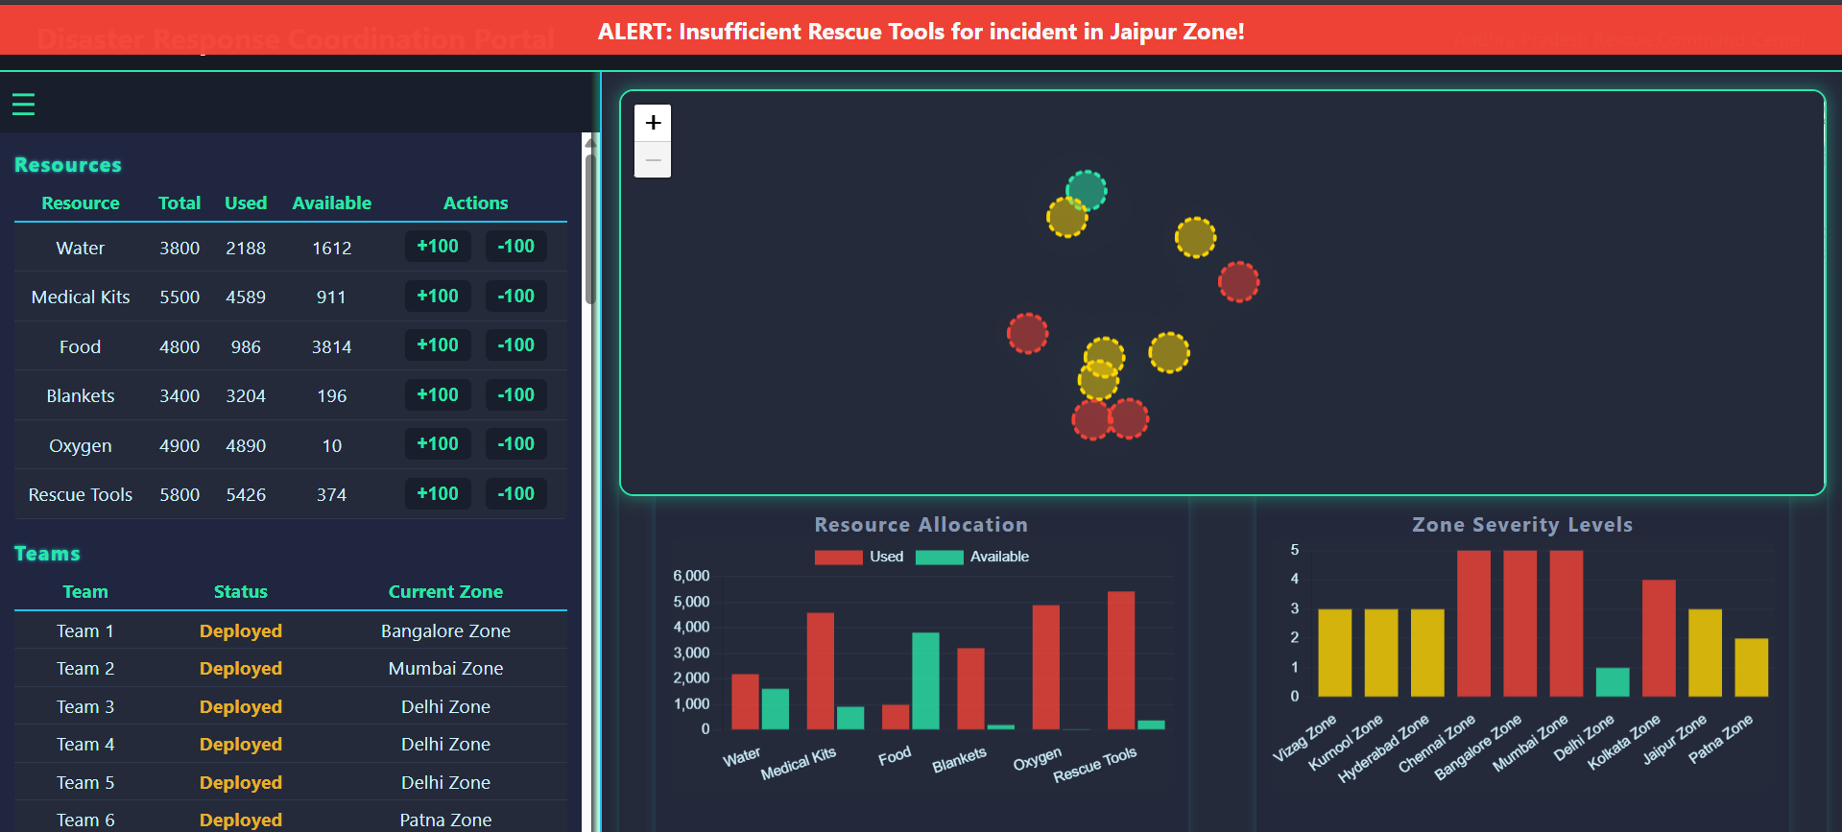
IMPLEMENTATION

Slide 8
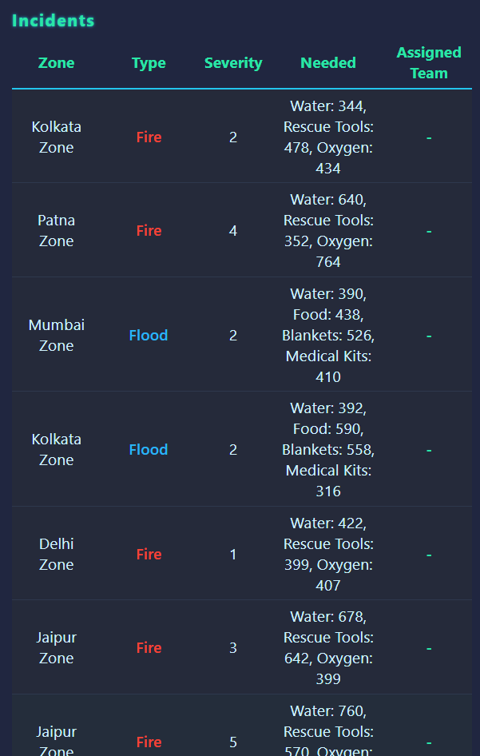
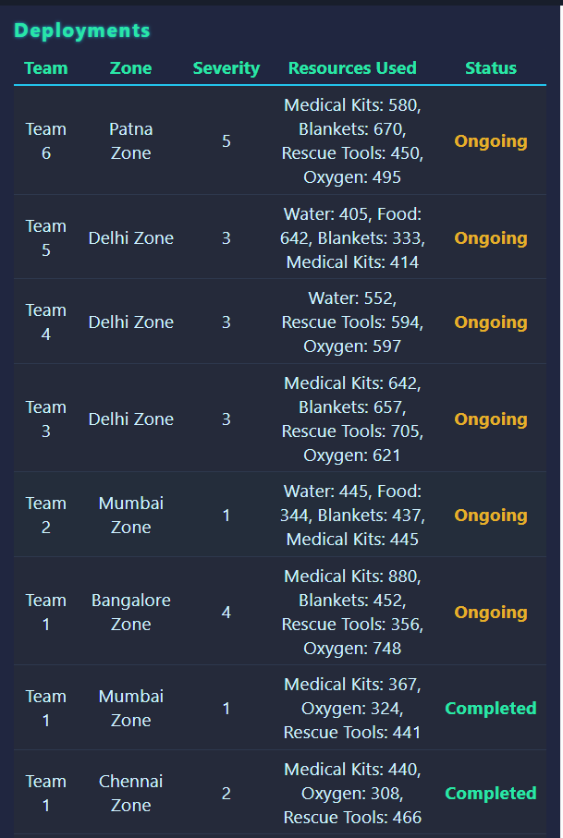

Slide 9
ADVANTAGES
Faster Communication: Helps teams share information quickly during emergencies.
Better Resource Management: Tracks and manages rescue materials and supplies efficiently
Real-Time Updates: Provides live information about affected areas and disaster status.
Improved Decision Making: Supports authorities in making quick and informed decisions.
Saves Lives: Helps in faster rescue and relief operations, reducing loss of life and damage.

Slide 10
APPLICATIONS
:
Earthquake and Flood Relief Operations – Helps coordinate rescue and relief efforts quickly.
Cyclone and Storm Emergency Management – Tracks affected areas and resource needs.
Fire and Industrial Accident Response – Guides teams to control fire and rescue victims.
Medical Emergencies during Disasters – Helps dispatch ambulances and medical teams.
Evacuation Planning and Crowd Management – Assists in safe and organized evacuation of people.

Slide 11
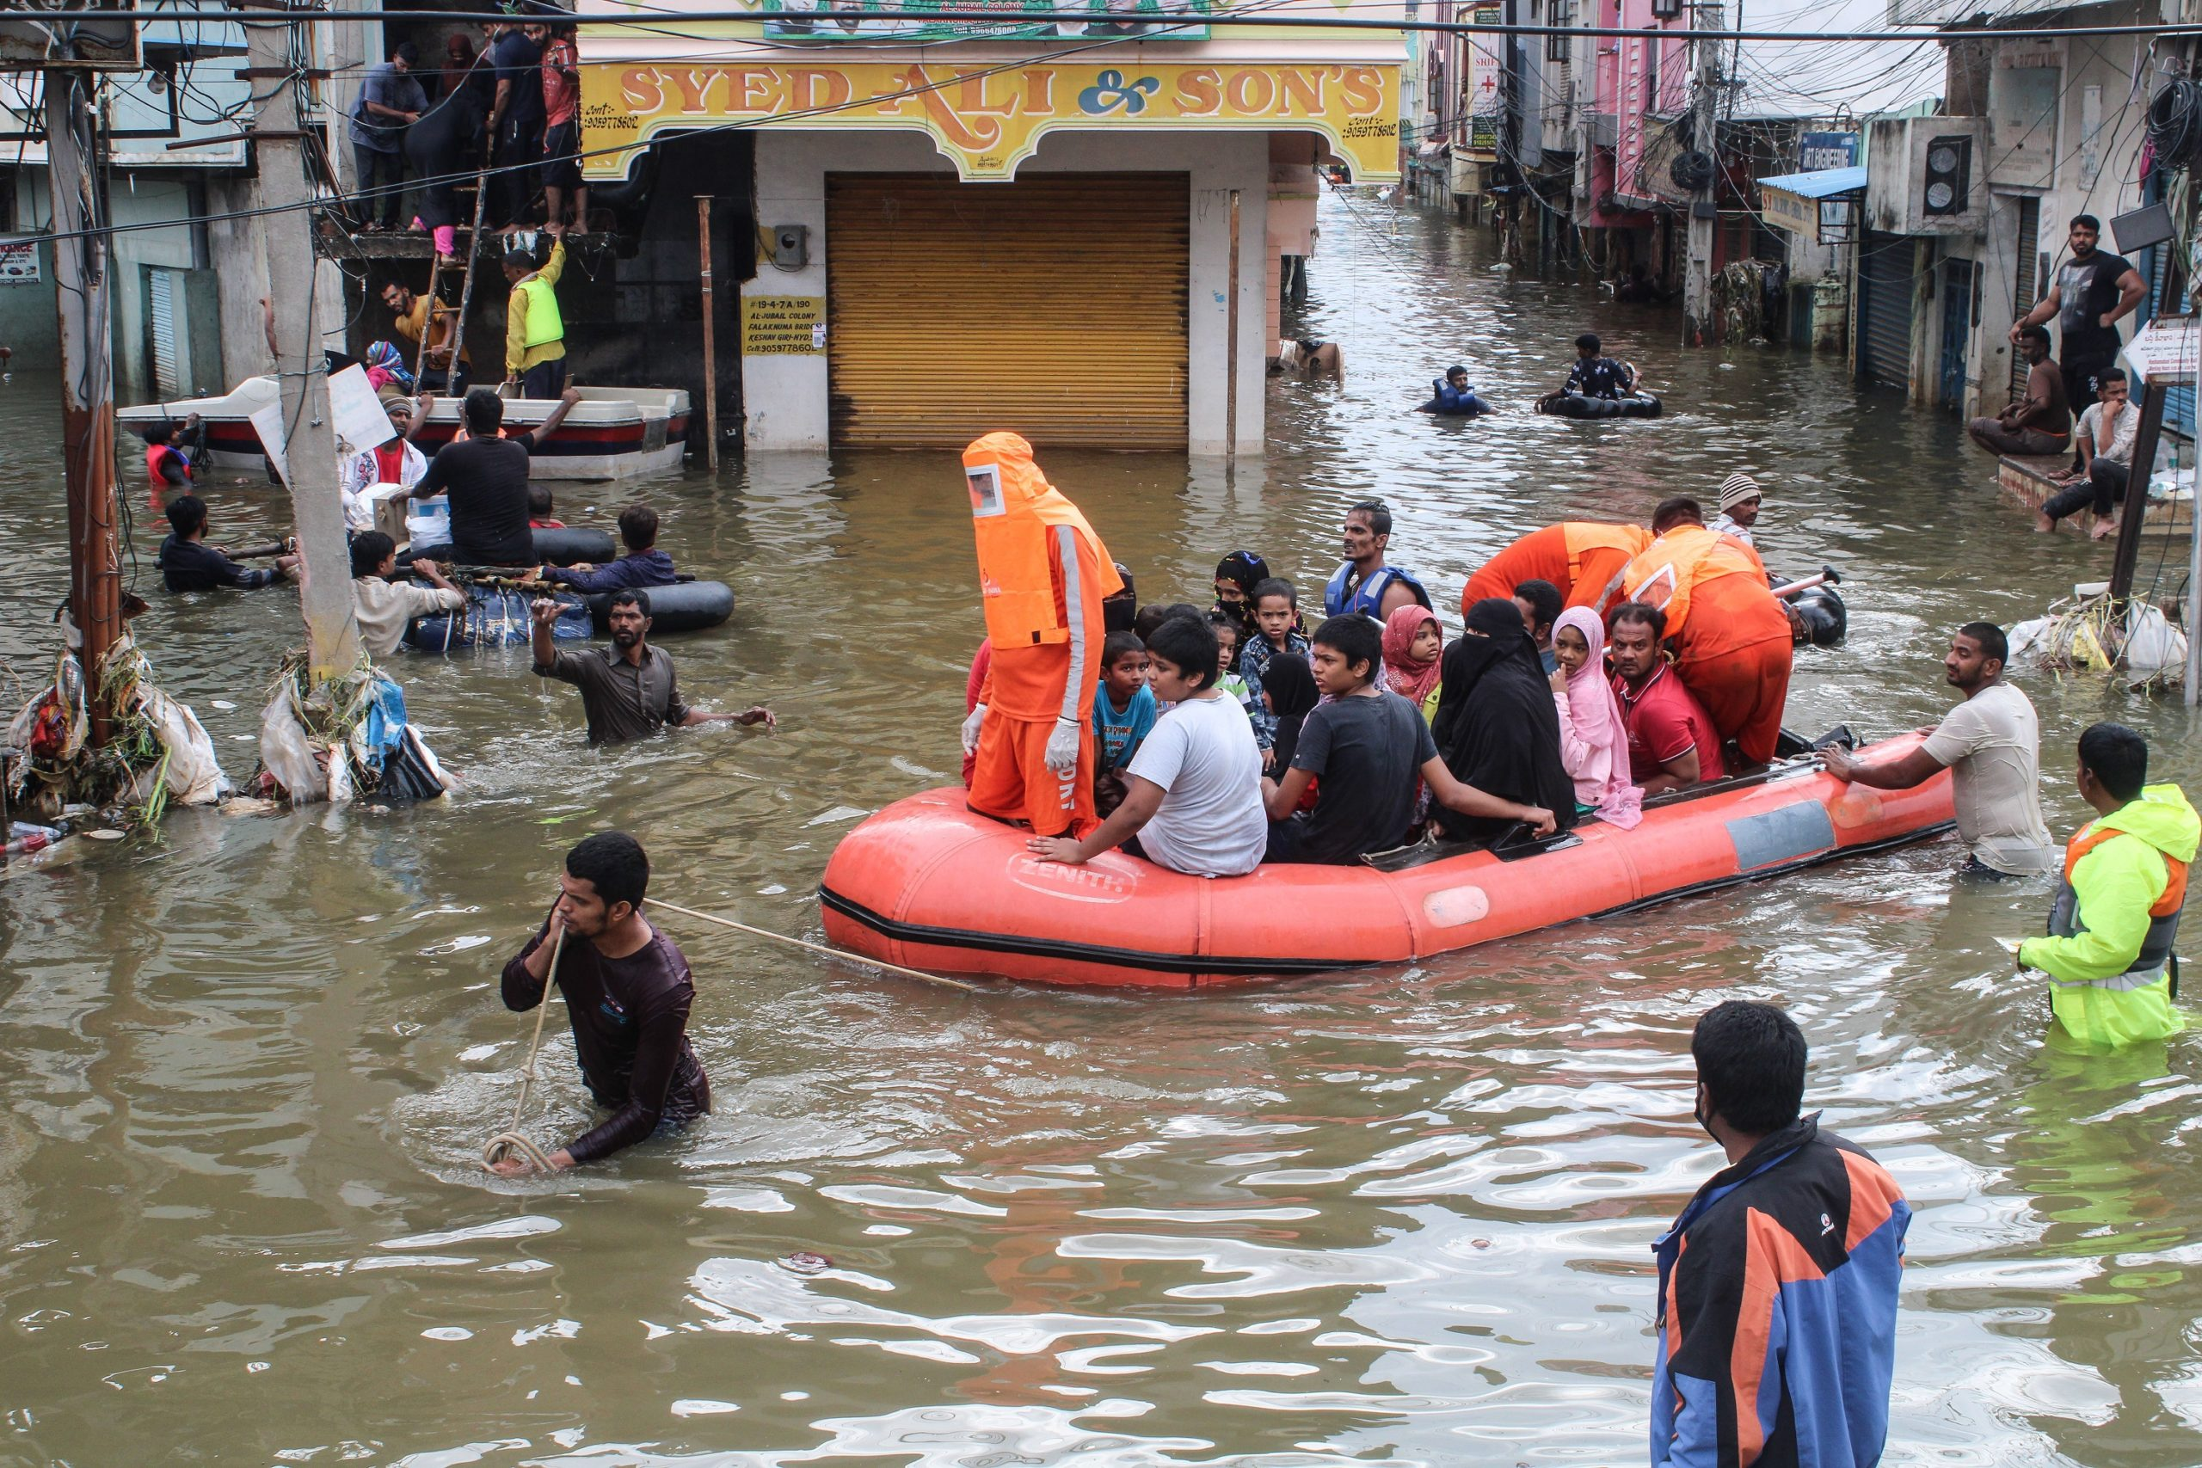
CONCLUSION
Platform improves coordination in emergencies
Balances automation with manual control
Future scope: AI-driven deployment, IoT & GIS integration

Slide 12


